Slide 1
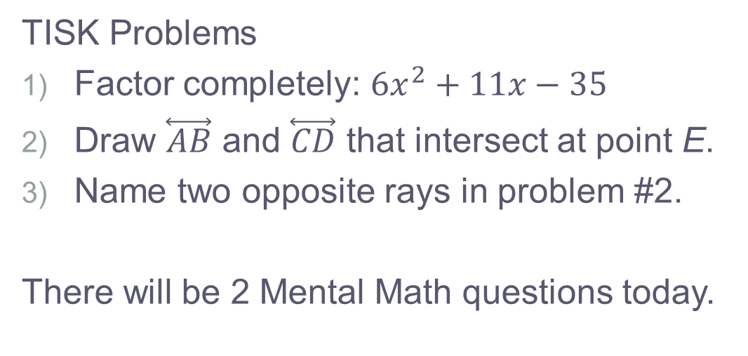
Thursday, September 6, 2012
TISK Problems
Factor completely: $6x^{2}+11x−35$
Draw $\overset{⃡}{AB}$ and $\overset{⃡}{CD}$ that intersect at point E.
Name two opposite rays in problem #2.
There will be 2 Mental Math questions today.
Homework: p. 135 #17-31 mentally; 38-40 & 44 in writing
Notes:
Mental Math
Start with the smallest prime number that’s greater than 12. Square it. Subtract 78. Add 8. Find 1/3. (33)
Start with the smallest prime number that’s greater than 8. Square it. Subtract 78. Add 6. Find 1/3. (17)

Slide 2
Homework Check
p. 128 #16-33 mentally; 34-43 writing

Slide 3
§3.2 Angles and Parallel Lines
Corresponding Angles Postulate
If two parallel lines are cut by a transversal, then corresponding angles are congruent.

Slide 4
Alternate Interior Angles Theorem (AIA Theorem)
If two parallel lines are cut by a transversal, then alternate interior angles are congruent.
You will prove this for homework!

Slide 5
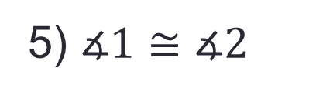
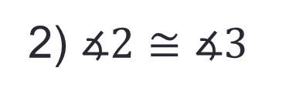

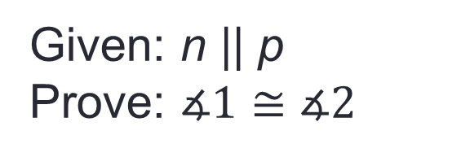
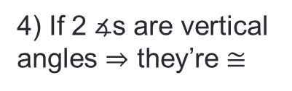
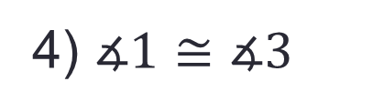
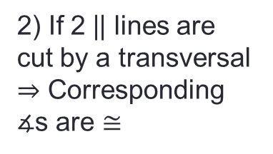
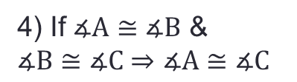
Alternate Exterior Angles Theorem (AEA Theorem)
If two parallel lines are cut by a transversal, then alternate exterior angles are congruent.
Statements | Reasons
n
1) n || p
1) given
p
1
3
2) $∡2≅∡3$
2) If 2 || lines are cut by a transversal $⇒$ Corresponding $∡$s are $≅$
2
m
3) $∡1\&∡3$ are vertical $∡$s
3) Assumed
Given: n || p
Prove: $∡1≅∡2$
4) If 2 $∡$s are vertical angles $⇒$ they’re $≅$
4) $∡1≅∡3$
5) $∡1≅∡2$
4) If $∡A≅∡B$ & $∡B≅∡C$ $⇒$ $∡A≅∡C$

Slide 6

Consecutive Interior Angles Theorem (CIA Theorem)
If two parallel lines are cut by a transversal, then consecutive interior angles are supplementary.
1
2
$$m∡1+m∡2=180°$$

Slide 7

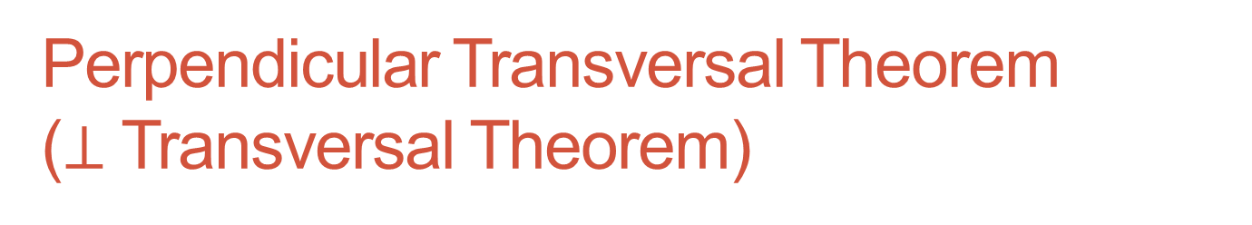
Perpendicular Transversal Theorem ($⊥$ Transversal Theorem)
If two parallel lines are cut by a transversal and the transversal is perpendicular to one of the lines, then it is perpendicular to the other line as well.
a
b
c
$$c⊥b$$

Slide 8
Homework
p. 135 #17-31 mentally; 38-40 & 44 in writing

